Slide 1
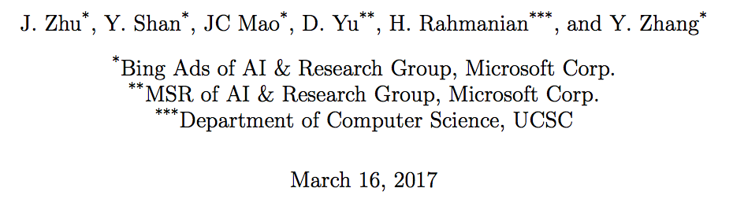
Deep Embedding Forest: Forest-based Serving with Deep Embedding Features

Slide 2
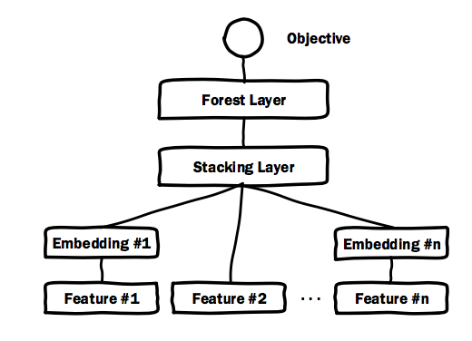
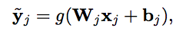
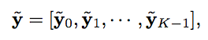
Model Components
Embedding layer:
Stacking layer:
K : the number of individual features
features with low dimensionality can be stacked without embedding

Slide 3
DEF Properties
minimize the effort of manual feature engineering
minimize the run-time latency
Prediction time:
the number of trees *
the average depth of the trees in the forest *
the total number of feature dimensions the decision or routing function depends on at each internal node

Slide 4
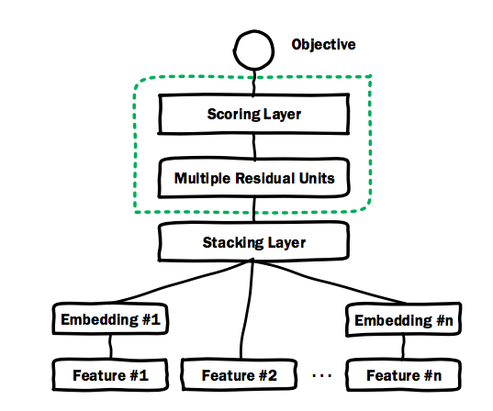
Initialize Embedding Layers with Deep Crossing
initialize {Wj}, {bj}
residual units ：provide Deep Crossing with superior convergence property and better control to avoid overfitting

Slide 5
Residual Net

Slide 6
Training Methodology
The benefits of deep crossing:
it is designed to enable large scale applications
handle low level sparse features with high dimensions
With the presence of a general scoring layer, Deep Crossing also works with all the objective functions of DEF.

Slide 7
Deep Crossing
Notes:
交叉网络的核心思想是以有效的方式应用显式特征交叉。交叉网络由交叉层组成，交叉网络的特殊结构使交叉特征的程度随着层深度的增加而增大
为了捕捉高度非线性的相互作用，模型并行地引入了一个深度网络。
链接层将两个并行网络的输出连接起来，经过一层全链接层得到输出
DCN能够有效地捕获有限度的有效特征的相互作用，学会高度非线性的相互作用，不需要人工特征工程或遍历搜索，并具有较低的计算成本。

Slide 8
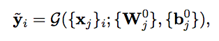
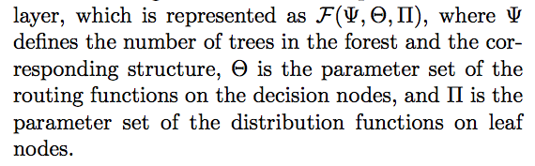
Initialize the Forest Layer with XGBoost and LightGBM
The embedding layers ：
XGBoost and LightGBM :{(t_{i} , y_{i}̃ )}
Notes:
树的数量；决策节点上路径选择函数的参数集；叶节点的分布函数的参数集

Slide 9
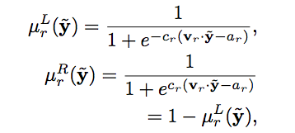
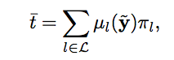
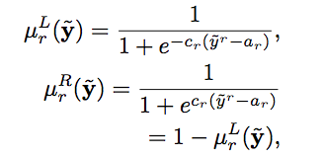
Joint Optimization with Partial Fuzzification
fuzzifying the decision functions of the internal nodes
each node is dedicated to only one dimension of the stacking vector
Notes:
在森林层中搜索最佳结构和相应的决策和权重参数通常依赖于贪婪方法，这与基于神经的嵌入层的基于梯度的搜索不兼容。

Slide 10
Two-Step DEF vs. Three-Step DEF
the prediction time of the Two-Step DEF is proportional to n_{t}d_{t}
the prediction time of the Three-Step DEF is proportional to n_{t}l_{t}

